Slide 1
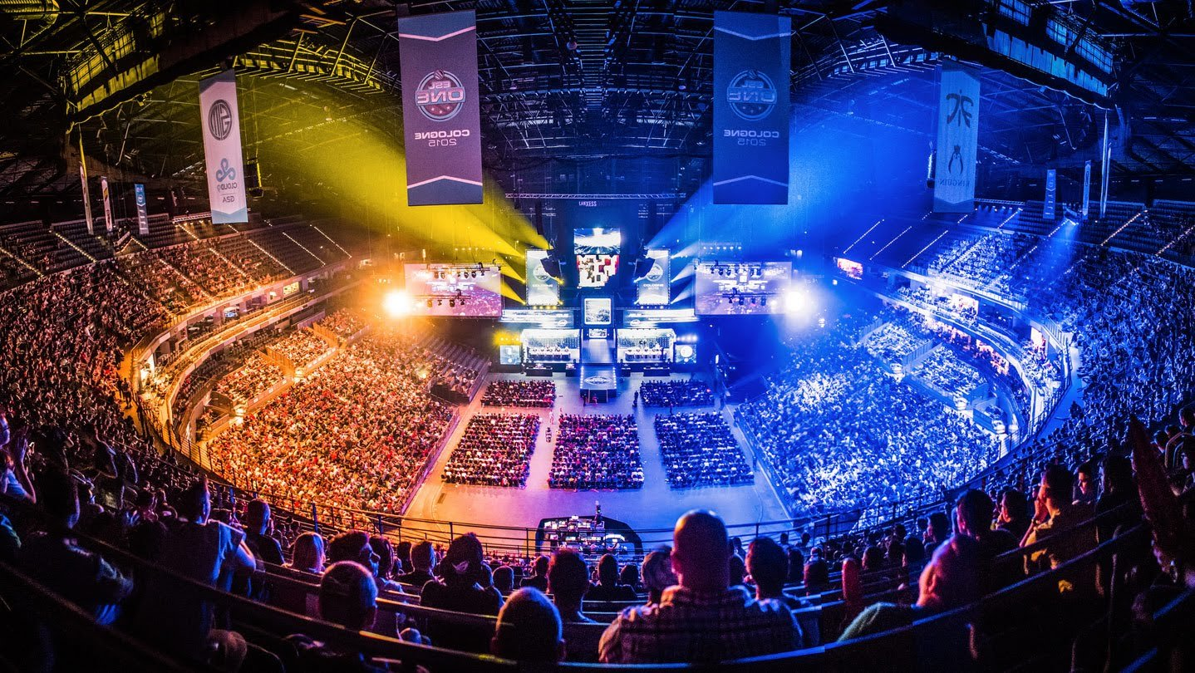
Notes:
This is ESL One Cologne, a competition held by ESL, known formerly as Electronic Sports League, the world’s largest producer and organizer of esports, or better known as, competitive videogame competitions. This is a viewer audience of over 14k individuals who are attending a competition between multiple teams from across the world. 16 teams gather at this competition to play for over 250k in prize money.

Slide 2
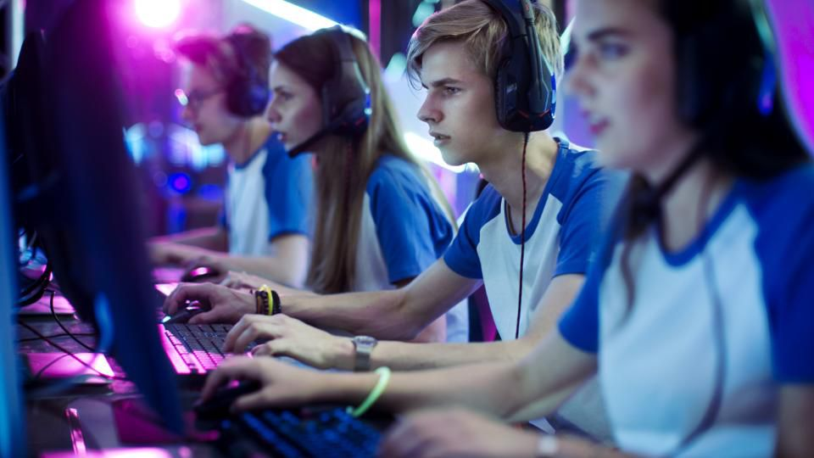
The Competitive Landscape of eSports

Slide 3
How will technological advances change the way sports are played and viewed? Will the eSports industry capture / engulf the sports industry?
Notes:
Question 1:
Players are able to substitute themselves out for robots to prevent injuries and exertion where it is not needed. Will this be implemented completely; where robots will compete against one another while being controlled by players who are retracted from the gameplay?
There have been advances in the uses of technology in the field of NFL; players are able to watch themselves play and make mistakes by watching renderings created through the use of camera usage and projections; players can put on VR headsets and watch themselves play as they did in practice. Can the technology be advanced to a point where players were able to perform without putting their bodies at risk or would that create a totally different game that would be shunned by the current fan base?

Slide 4








Introduction
Game Streaming
eSports
Content creation through streams
Advertising, subscriptions, and partner programs → merch sales & channel subscriptions
Affiliate marketing, in-game donations, subscriptions, donations, partnerships, merch, sponsorships and in-game items
Organizations such as Valve Corporation, Riot Games as well as Epic Games
Merchandise, sponsorships, advertising, media rights and game publisher fees
Notes:
Competitive Gaming:
The global gaming industry is a $100 Billion industry. When it comes to the streaming industry, over 665 million stream and watch streams and over $4.5 billion is produced through ad revenue and spending on videogame content. The industry revolves around generally FTP games and generates ad revenue through the following methods. The most popular games include DOTA 2, LOL, Overwatch, CS:GO and recently FortNite. Streamers can generate revenues through a multitude of ways indicated above under bullet 3.
eSports:
eSports is the competitive events where organizers such as ^^ host competitions in which teams compete against one another to determine the winner of the prize pool. These events generate revenue through the above methods and create prize pools for teams to compete for.

Slide 5
Some Less Known Facts about eSports
Notes:
The industry is a fast-growing industry with positive CAGRs in both revenues as well as the number of people spending time watching; Revenue is growing at a CAGR of 20.3 %, Viewership is growing at a total of 15.95% where frequent viewers are growing at 18.77% and occasional viewers are growing at 13.62%. This is interesting and great for the future of eSports when mainly looking into the difference between growth in frequent viewers vs. occasional viewers. Frequent viewers tend to be players who play themselves as well as stream and watch eSports. A greater increase in frequent viewers speaks to the industry characteristic in which videogames are becoming more popular and less of a looked-down-upon industry and mode of entertainment.
Another interesting fact to look at is the money that is prevalent in eSports; The international 2017, a DOTA 2 competition, had a total prize pool of over $24 million whereas other sports competitions had less, including the NBA Championship, the FIFA Confederations Cup as well as the Masters Tournament. This is significant as a lot of money lies within the industry; demand for highly skilled and competitive players are huge, demand for quality streams and competitions is growing, demand for innovative and exciting ways of consuming entertainment is growing as well. These are all characteristics that point to an industry that will experience strong growth and may provide great investment potential for investors and companies.

Slide 6
How will entertainment companies react to the surge in gaming viewership and the change in consumer trends towards competitive gaming streams? Will they react aggressively or attempt to take a cut of the pie?
Will there become a culture around eSports such that organizations, schools, and states focus on breeding, scouting and drafting players that perform exceptionally?
Notes:
Question 1:
The 2016 LOL Championships attracted 43 million viewers, both live and through streams. With a current viewership of 665 million, consumers interested in competitive gaming and eSports are more-than-ever switching from traditional cable television and online subscription entertainment services. Last year, consumers watching the LOL Championship exceeded the amount of consumers watching the NBA Finals by 5 million viewers. Recently, a Singapore-based Martial Arts promoter partnered with a Japanese ad agency to pump $50 million into a competitive eSports series hosting a multitude of the most “blockbuster” online games; the companies are One Championship and Dentsu, respectively. Will ventures like this one continue to be seen in the eSports landscape?
Question 2:
There is a strong breeding ground around the sports of today; students and children are placed in sports camps at a young age in hopes to challenge them physical and mentally while simultaneously creating players who have years of talent under their belt. These children grow to play in the leagues of the different national and international competitions. Will the same occur for eSports? Take note that the highest earning eSports gamer earns $3.5 million; German Takhasomi. When using the NBA as a comparison and comparing Wilt Chamberlain’s 65k salary in 1959 to Lebron James’ 85.5M salary in 2018, we realize that the NBA realized a CAGR of 12.44% each year in top salary. This was during the explosion in popularity of the NBA. If the same occurred with eSports, top eSports gamers could be making 14.3M by 2030.

Slide 7
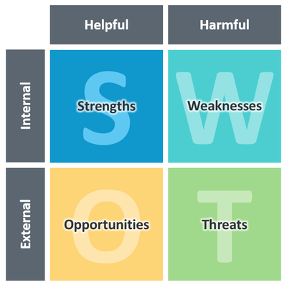
Analyzing eSports as a Business Opportunity
Industry Rivalry
Threat of New Entrants
Bargaining Power of Buyers
Threat of Substitutes
Bargaining Power of Suppliers

Slide 8
SWOT: Internal Factors
Strengths
Weaknesses
Attracting a massive audience and viewership is growing
Significant year-over-year growth
Captivation of one of the hardest target markets to reach – male millennials
Limited infrastructure
Industry regulations
Lack of education
Cheating

Slide 9
SWOT: External Factors
Opportunities
Threats
Structural & Efficiency Plays
New Payment Operations
Betting
Segmented Fanbase
Game Disruption
Healthy Living Advocacy
Generational changes

Slide 10
Porter’s Five Forces: Bargaining Power
Suppliers → Varied
Buyers → Medium
Streaming Websites (low)
Websites that are dedicated to the content produced by the industry
Hardware (low)
Large number of suppliers of homogeneous products
Venues (high)
Competition with other entertainers for venue space
Customers demand improvements in distribution
Consumers receive final product – they have limited demand power
Consumers are vast; no one consumer controls demand of product
Threat of backward integration is non-existent

Slide 11
Porter’s Five Forces: Intra-Industry Rivalry
Only small number of competitors in the industry (Riot Games, Valve and Blizzard)
eSports is a viewer based industry
Attracting viewers from other games is hard since games are very different and therefore specific to a particular audience
Lack of differentiation in the way products are presented to the audience

Slide 12
Porter’s Five Forces: Threats
New Entrants → Low
Substitution → Medium
Product Differentiation
Competitions revolve around multiplayer games – producing a game that is unique and competitive → product differentiation
Capital Requirements
Producing new games is resource intensive
Venue hosting and partnerships may be costly to new entrants
Survivor Bias
Creating a game that is highly demanded by consumers tends to involve luck
Each game is different in its own way and therefore the consumers that they attract are loyal to consuming eSports entertainment
Consumer preference change can result in a permanent loss of the consumer
Entertainment products that generate emotional responses from viewers
Movies
Television series
Spectator sports

Slide 13
Implications: eSports and CG Industry
With the growing demand for content and ways to enjoy the content along with the ability to disrupt other industries, how will eSports and Competitive Gaming fare in the future?
Will the industries of eSports and Competitive Gaming be the next Netflix in consumer entertainment or will the industry flop along with the dying popularity of some of the videogames that driving the industry?

Slide 14
Appendix: Figure 1

Slide 15
https://domain.me/esports-money/
https://www.weforum.org/agenda/2018/07/the-explosive-growth-of-esports/
https://www.sciencedirect.com/science/article/pii/S1441352317300700
https://www.weforum.org/agenda/2017/06/3-surprising-facts-about-the-gaming-industry-and-why-you-should-start-paying-attention
https://www.cnet.com/news/one-championship-pumps-in-50m-to-bring-the-fight-online-in-asia/?fbclid=IwAR3msOYxuSlEL6Q6X_jiUnmken_LyotUQc3UQGm_iUTTDE86fjsGSzAPnGw
https://www.forbes.com/sites/markhall/2018/11/07/sports-franchises-embrace-esports/#45b2d01f17a7
https://www.statista.com/statistics/490522/global-esports-market-revenue/
https://www.statista.com/statistics/490480/global-esports-audience-size-viewer-type/
https://blog.reelio.com/how-much-do-twitch-streamers-make
http://hackingrevenue.com/revenue/revenue-spotlight-twitch-tv/
https://www.quora.com/What-were-salaries-like-for-professional-athletes-back-in-the-old-days

